Slide 1
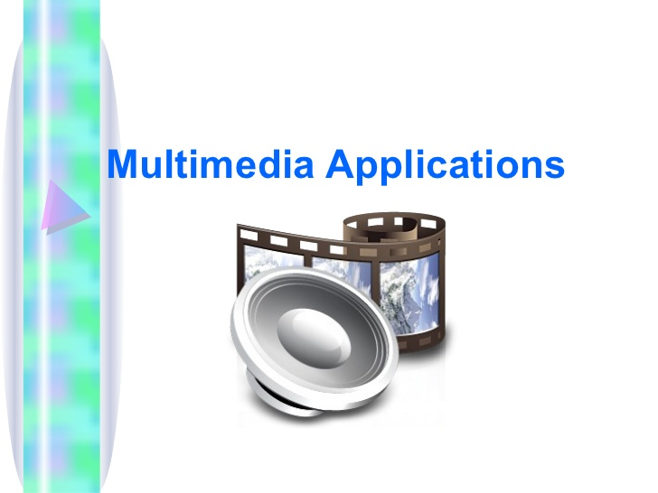
Multimedia and Applications

Slide 2
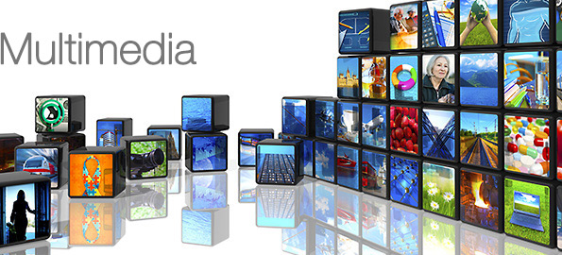
Multimedia
DEFINITION - The term multimedia refers to creation of files by combining various media. Multimedia is a combination of text, images, audio, video and animations in a single file.
A multimedia file may contain pictures, sounds and animations and some text also.

Slide 3
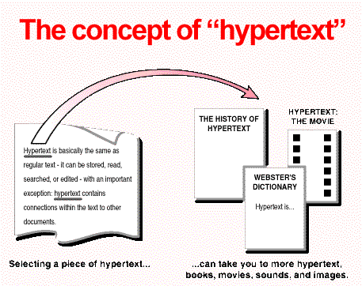
Hypertext
Hyperlink is a link which is used to navigate within a website.
The text with which the user can navigate is called “Hypertext”.

Slide 4
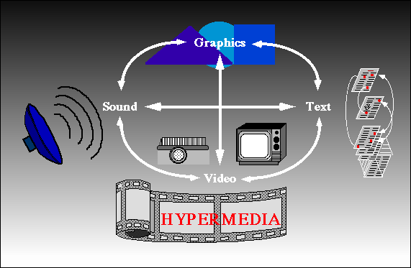
Hypermedia
Multimedia files or pages can also be linked by using various media like images, videos, animations and etc. Such media is called Hypermedia.

Slide 5
More …
A multimedia project can take a form of a website or a webpage or an application running on the computer screen or etc.
Whenever a multimedia project is sold as a product to customers , it is called as “Multimedia Title”.

Slide 6
Hypergraphics
Hypergraphics merges text with more visual ways of communication.
Any graphic that links to another useful information is called as hypergraphics.
A hypergraphic is the graphics counterpart of hypertext on the Web.
Instead of clicking a word or phrase, an icon or image is clicked to jump to another section of the page or to another page.
In practice, a hypergraphic is called a "clickable image.“
Eg: image map in html, flash animation links.

Slide 7
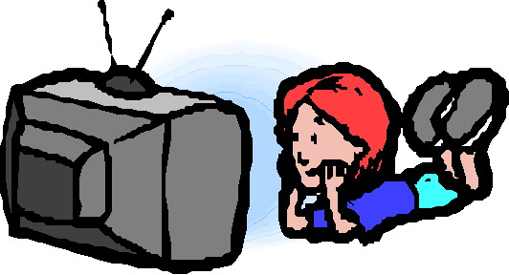
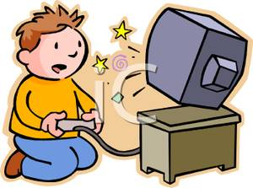
Types of Multimedia Projects
Linear Multimedia Projects:
Projects which don’t require
any user interaction
Example – Movie , Non- Interactive Video etc
Non-Linear Multimedia Projects:
Projects Require user interaction
Example – Gaming , Chatting etc

Slide 8
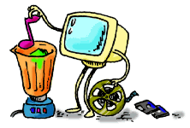
Authoring Tools
Use to merge multimedia elements (text, audio, graphic, animation, video) into a project.
Designed to manage individual multimedia elements and provide user interaction (if required).

Slide 9
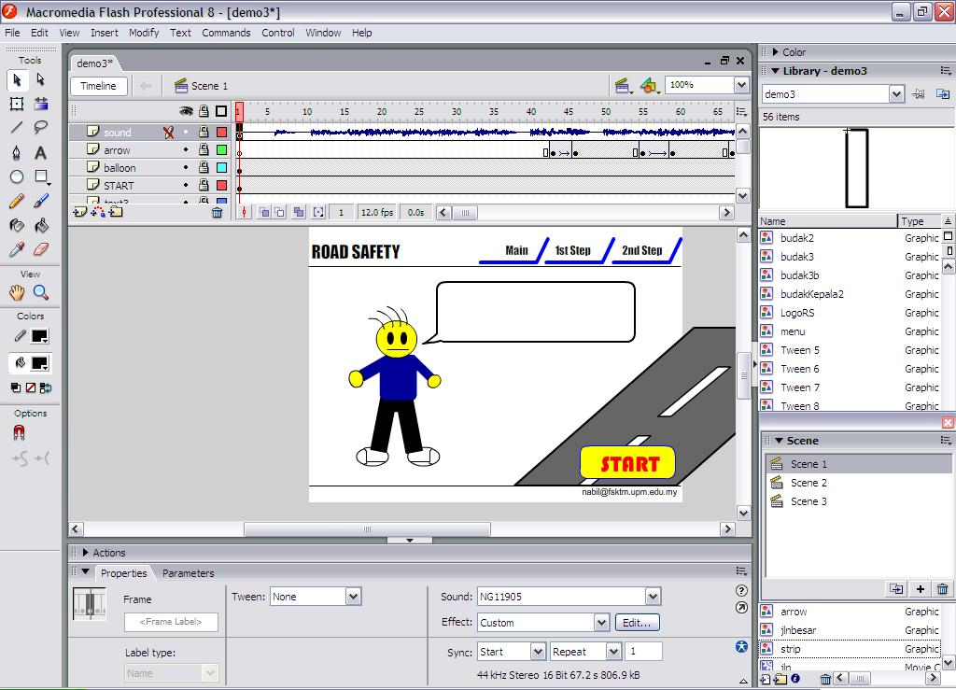
Authoring Tools
Example:
  Macromedia Authorware
  Macromedia Director
  Macromedia Flash
  Microsoft Power Point

Slide 10

Animation is a process of displaying multiple images one after the another, in a particular sequence at a rate, more than 16 frames or pictures per second.
Most famous example of animation is a movie film.
Animation can be used to present a slowly occuring process at a fast rate or a fast occuring process at a slow rate.
Multimedia projects use animations to increase the effectiveness and under-standability of the project.
Eg: rotating effect on a product is more eye catchy.

Slide 11

Animation techniques:
  CEL animation:
    cel animation was made popular by disney.
    In this every frame of the movie contains a different picture.
    And then these frames are run at a rate 24 frames per second.
    This requires more imagination and hardwork of the artist.
  Computer animation:
    Uses same concept as Cel animation.
    Older concepts of drawing by an artist is replaced by drawing in computer using layers, key frames and tweening technologies.
    These animations are created in special softwares. Eg: flash.

Slide 12
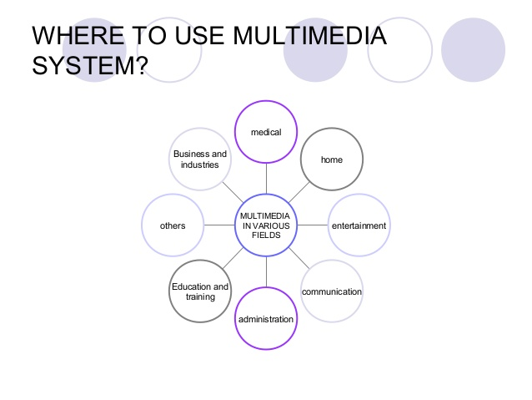
Applications of Multimedia
Multimedia is used in many fields.
Used to attract consumers.
Used to elaborate projects in a better way.
Used in
  engineering
  Animation
  Planning
  Designing
  Education

Slide 13
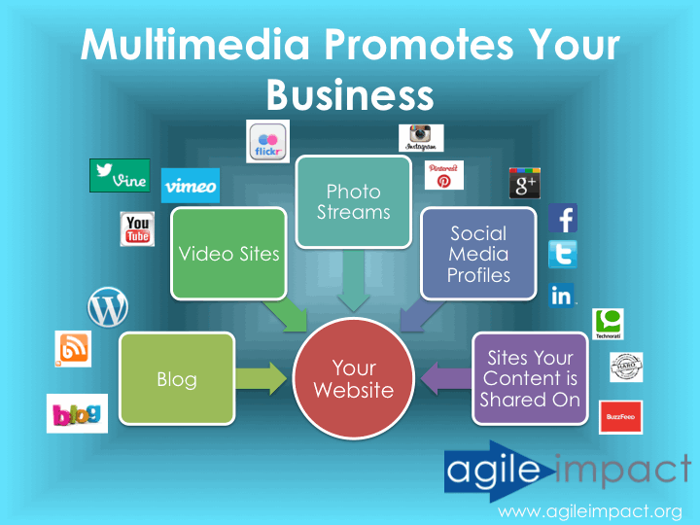
Multimedia in Business:
  Used to present a product to consumers.
  Used to convince management for a new product or project.
  Used in employee training.
  The business meetings also use audio and video conferencing.
  Used to predict future scope of a product and etc

Slide 14
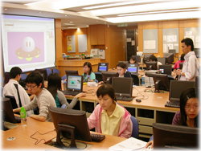
Multimedia in Science and Technology:
  Used to analyze different elements and their chemical components.
  Used in simulation
  Used for scenario based future projections.
  In predicting the weather.
  To demonstrate presence of various resources in various parts of the earth.

Slide 15
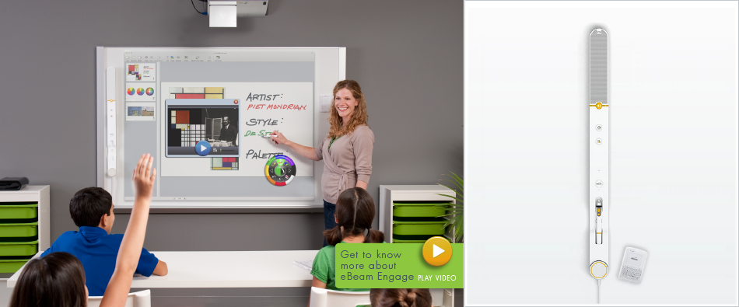
Multimedia in Education:
  Used to teach difficult concepts of science, maths and computers in a very easy manner.
  Projectors help teachers in demonstrating lectures in better way.
  White boards and books can be replaced by animations in educational institutes.
  Teaching to fly in simulators before real flying and etc.

Slide 16
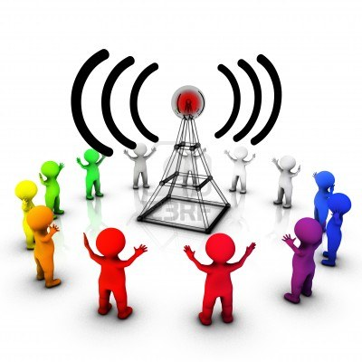
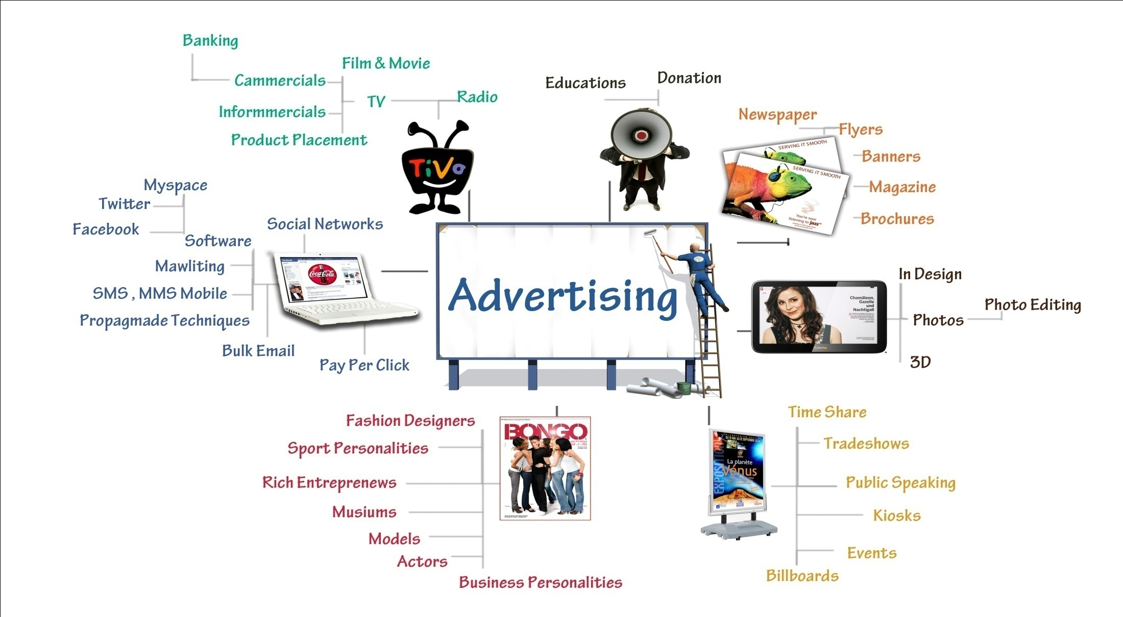
Multimedia in Advertisement and marketing:
  Animations are used to create eye catchy ads.
  Used to attract costomers.
  Animation is used by sales professionals while demonstrating the product profile to customers.
  Eg: very famous zoo zoo ad compaign and etc.

Slide 17
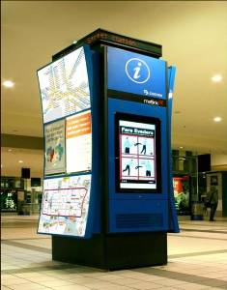
Multimedia in Kiosks –
Multimedia kiosks are installed in hotels, train stations , shopping malls.
These kiosks provide
information about various
products and events.
Example – In station , a traveller can enquire about trains and find a particular train of interest.

Slide 18
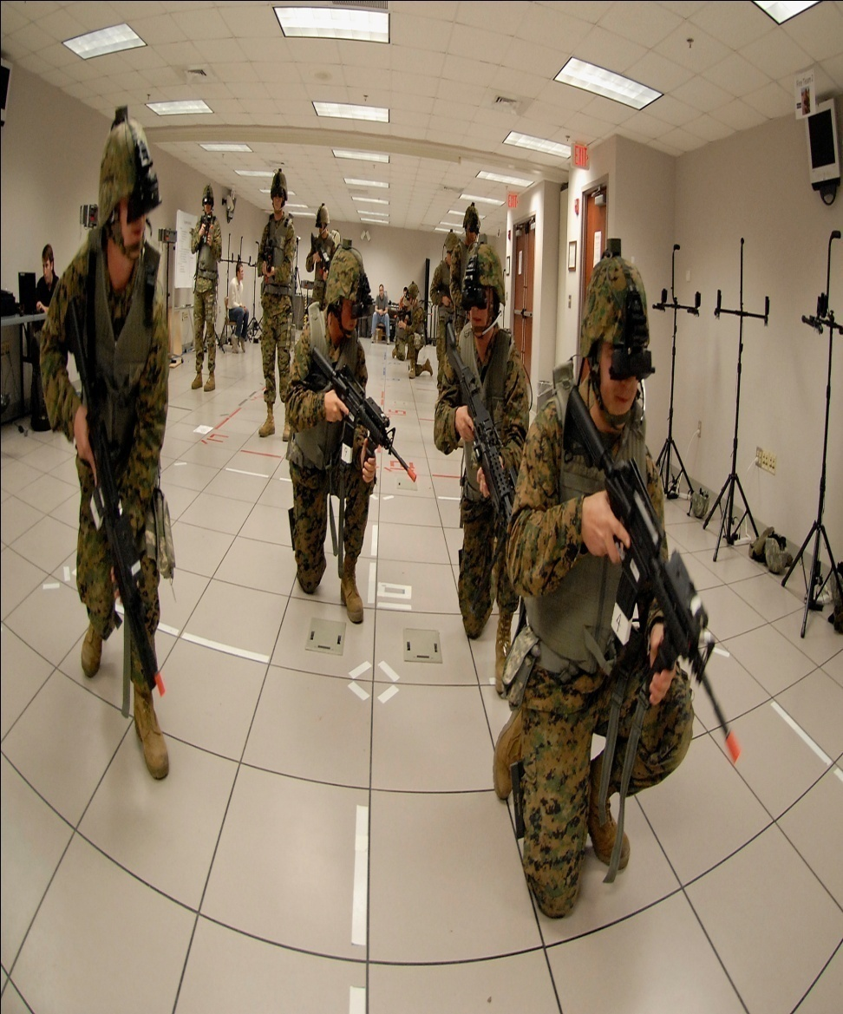
Multimedia in Virtual Reality:
  Virtual reality is a new field in computers that has been created with multimedia.
  It makes you feel about some environment or object which is actually not present.
  Digital gloves, sensitive suits and shoes etc.
  Main application of virtual reality is making simulators.
  Eg: special war simulator by US army and etc.

Slide 19
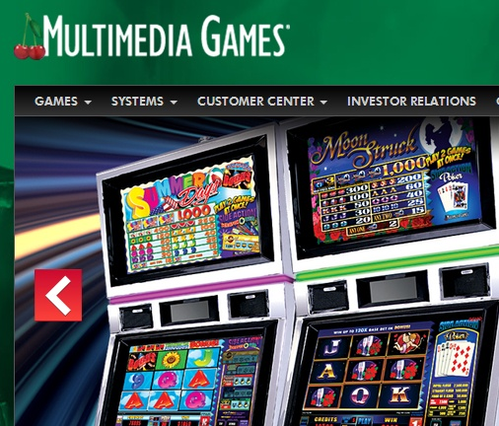

Multimedia in Gaming:
  Most widely used application of animation and multimedia.
  2-d and 3-d gaming.
  Many many games.

Slide 20
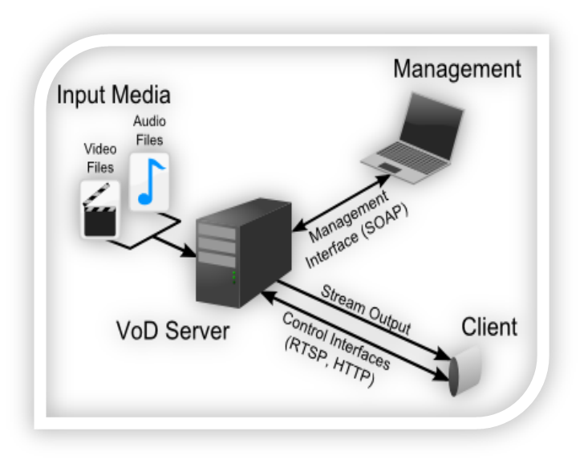
VIDEO ON DEMAND
Video On Demand (VOD) is a feature of digital cable that allows you to rent movies and programs from the comfort of your home.
You can pause, fast-forward or rewind
these programs with your remote just
like you would with a DVD player or VCR.
Charges are applied for movies from the
regular VOD menu
Kids on Demand: All the great free shows which kids love.
Music on Demand: Favorite music channels
Movies on Demand: Favorite movie channels

Slide 21
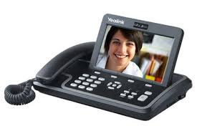
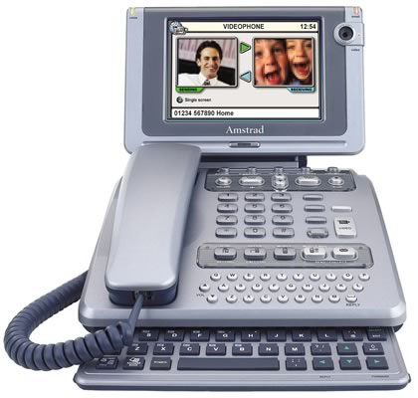
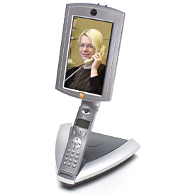
Videophone
A videophone is a telephone with a video display, capable of simultaneous video and audio for communication between people in real-time.
Videophone service provided the first form of video telephony, later to be followed by videoconferencing, webcams.

Slide 22
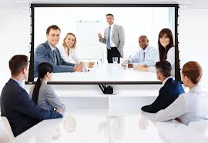
Video Conferencing

Slide 23
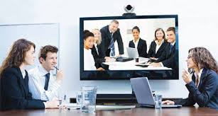
Video Conferencing
Videoconferencing(VC) is the conduct of a videoconference (also known as a video conference or video teleconference) by a set of telecommunication technologies which allow two or more locations to communicate by simultaneous two-way video and audio transmissions.

Slide 24
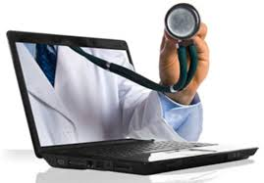
Tele-Medicine
Telemedicine is the use of telecommunication and information technologies in order to provide clinical health care at a distance.
It helps eliminate distance barriers and can improve access to medical services that would often not be consistently available in distant rural communities.

Slide 25

Any Questions???

